Slide 1
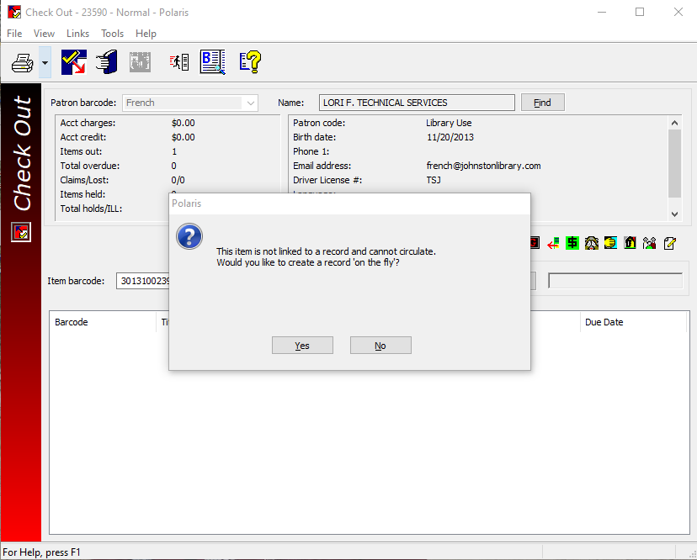
On-The-Fly
What to do when a check-out produces an “On-The-Fly (OTF)” block.
The first step is to select “No” and scan the item again.
If you still receive this message select “Yes” and proceed with creating an On-The-Fly record.

Slide 2
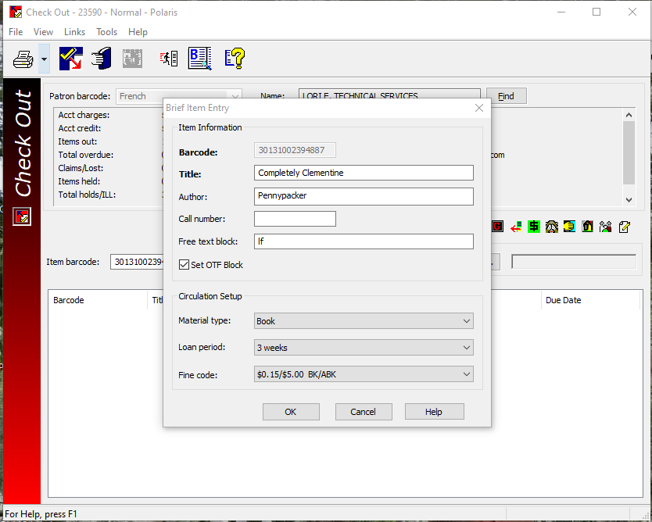
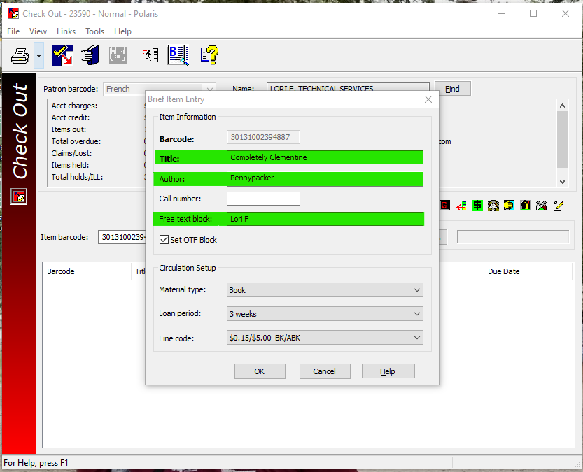
You will receive a “Brief Item Entry” prompt.
Fill in the Title & Author fields and add your name to the “Free text block” field and select “OK”

Slide 3
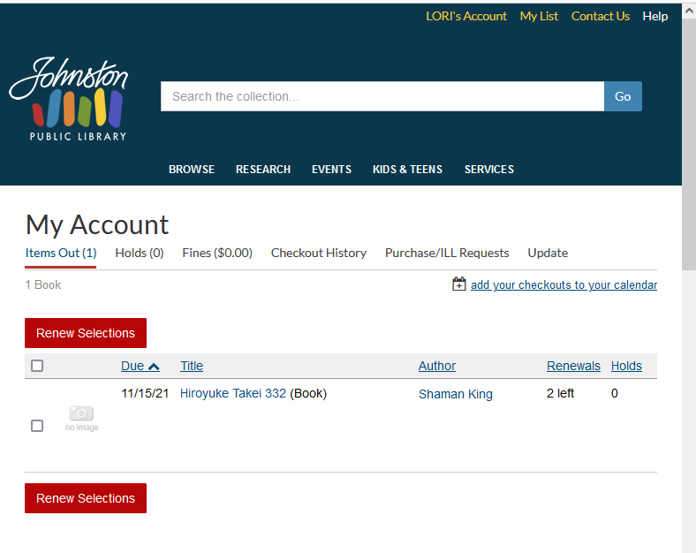
Why is this important?
Adding this information to the On-The-Fly prompt will supply the patron with an accurate check-out list and the ability to renew that item from the PAC.

Slide 4
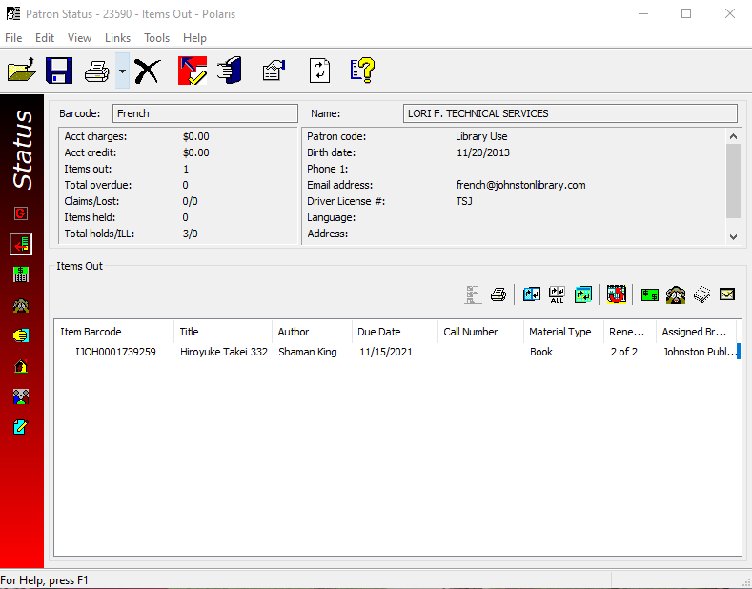
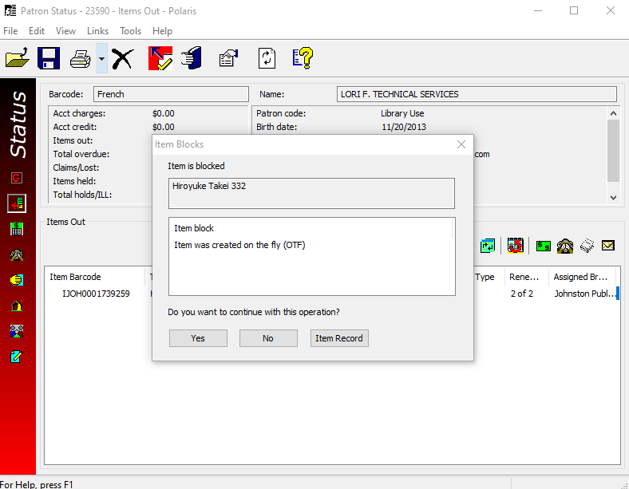
The item(s) can also be more easily identified and renewed by staff.
You will receive a block. Select “Yes” and the item will renew.

Slide 5
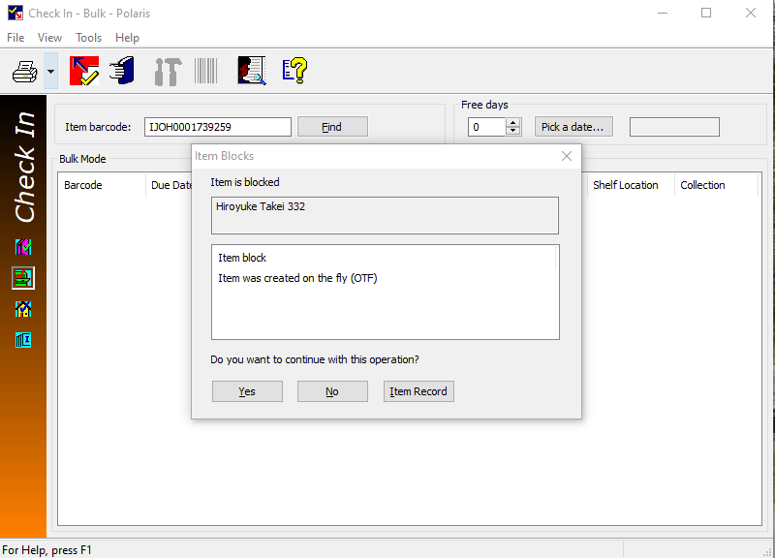
A Final Note
On-The-Fly(OTF) returns may create a blocking note. Please select “Yes” and then place the item on the TS shelf. I will research why the item was “OTF” and resolve any problems.
Remember, there is nothing you can do that is fatal. It can all be addressed and corrected. These few steps just make that a easier.

